Slide 1
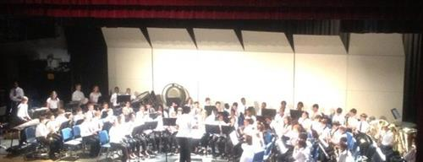
Kiser Middle School
Beginning Band
Student & Parent
Information

Slide 2
Welcome to the Kiser Tiger Band!
Kiser Middle School Bands has enjoyed a tradition of excellence since the school's inception. This program is dedicated to giving students the chance to grow musically, socially, and academically. The band is also supported by the Kiser Middle School Band Boosters, whose mission is to support all band students through direct assistance and advocacy. The purpose of the Kiser Middle School Band program is to impart an appreciation of music to all our students through study, practice, and performance.
Follow us @kisertigerband on: Instagram, Facebook and X

Slide 3
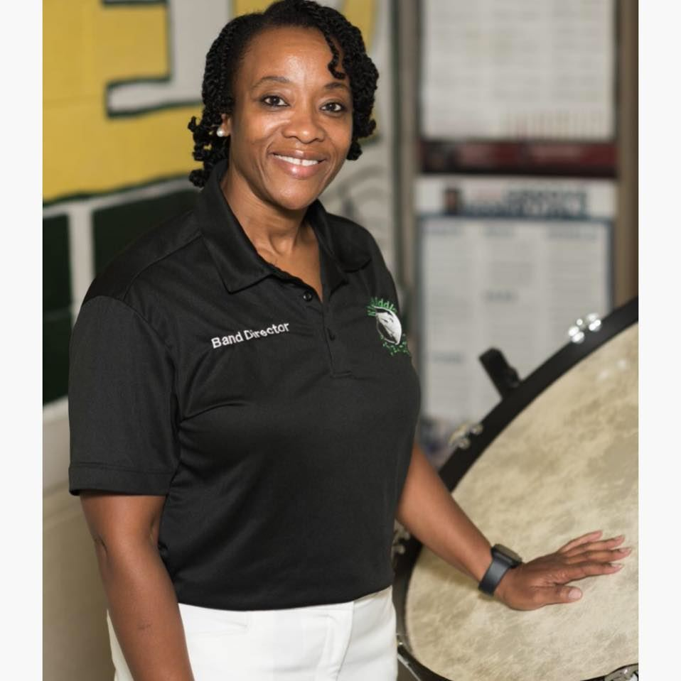
Mrs. White
Tammy White, director of bands at Kiser Middle School graduated from the University of North Carolina at Greensboro with a Bachelor of Music and Master of School Administration degrees. Performance highlights for Mrs. White include performing with the East Carolina University Marching Pirates and performing at the John F. Kennedy Center for the Performing Arts in Washington, DC, with the University of North Carolina at Greensboro Wind Ensemble.
Mrs. White is a student-centered music educator beginning her 30th year in education, with 24 of those years teaching at Kiser Middle School. The Kiser Middle School Concert Bands have earned top ratings at district and regional music festivals. Mrs. White is an avid advocate for the arts, works closely with community partners and is active in professional learning for aspiring music educators. Mrs. White’s professional affiliations include the National Association for Music Educators, the North Carolina Music Educators Association, the North Carolina Bandmasters Association, Association of Black Women Band Directors, and Women Band Directors International.
Mrs. White has been selected as the Kiser Middle School Parent Teacher Association Teacher of the Year, the Guilford County Schools Employee of the Month, the Kiser Middle School Teacher of the Year, the Guilford County Schools Teacher of the Year, serves as the current TeachNC Ambassador for Guilford County Schools. and received national recognition by the GRAMMY Foundation by being thrice selected as a quarterfinalist for the Grammy Music Educator of the Year Award. Most recently, Ms. White was celebrated as the 2024 Band Director of the Year by the Central District of the North Carolina Bandmasters Association, a testament to her outstanding contributions to music education and her exemplary leadership at Kiser Middle School.
The Kiser Middle School Band program encompasses a rich tradition of musical excellence.
.

Slide 4
Band Instrument Selection Process
The first step is in choosing an instrument. The choices of instruments are as follows: flute, clarinet, trumpet, trombone, baritone (school owned instrument), and tuba (school owned instrument). If your child is selecting one of the instruments listed above, you may go ahead and procure your instrument. If your child is interested in playing the baritone or tuba, please contact me. Students will need to have an instrument in class by September 3. This will be the first day of instrumental instruction for students.
The alto saxophone section will be limited to ten students and will be filled on a "first come/first serve" basis. Please do not purchase or rent an alto saxophone until a spot has been confirmed. A google document form for an alto saxophone “spot” will need to be submitted. Parents will be notified of their child either receiving one of the five spots or having to select their second choice of instrument. The link/QR code for access to the form will be included in the beginning band information letter mailed to parents during the week of August 5. Please email me with any questions regarding this process at whitet@gcsnc.com.

Slide 5
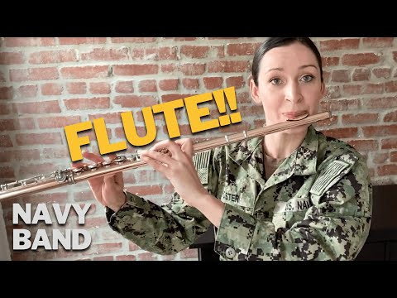
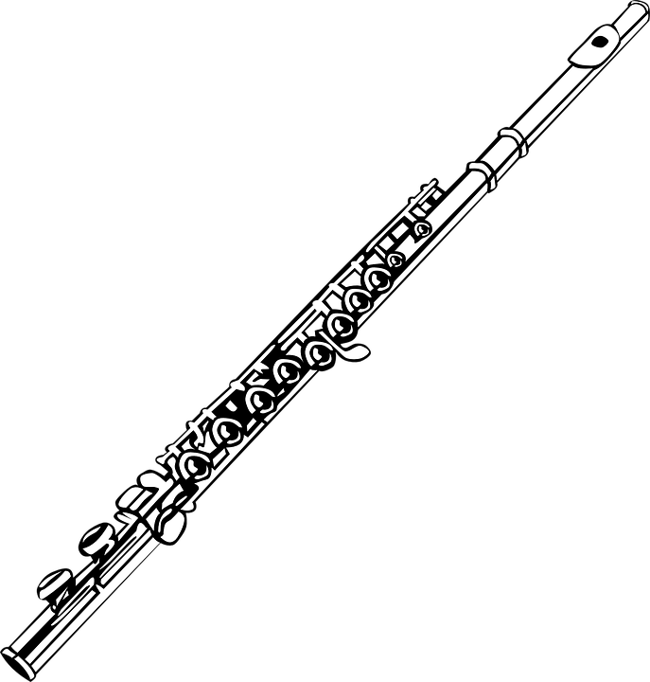
Woodwind Instruments
FLUTE
ABOUT THE FLUTE:
The flute is the highest-pitched woodwind instrument.
Flute instruction begins with several complicated fingerings that are good for students with great dexterity.
Flutes often play the melody, which requires quick fingers.
PHYSICAL CHARACTERISTICS NEEDED:
Flute players need to hold the instrument out to their right, and will use their lower lip and fingers to balance the instrument.
Flutists should be able to say “pooh” and create and hold a pouty lower lip, (similar to blowing into a pop bottle).
Play the video
Play the video

Slide 6
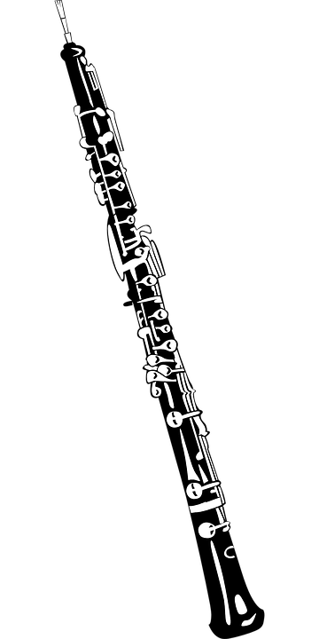
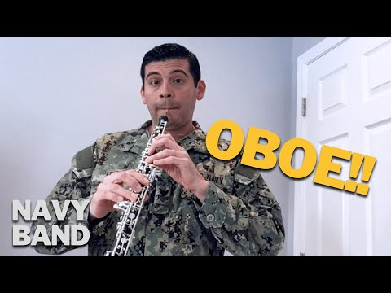
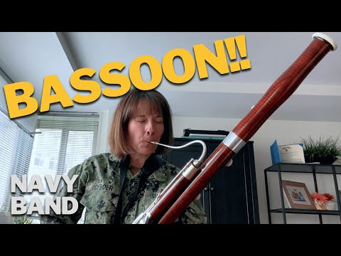
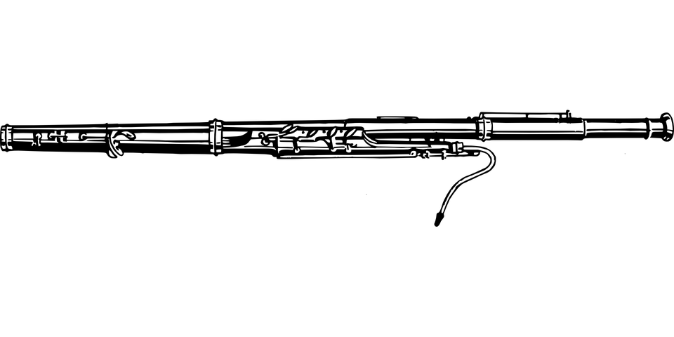
Woodwind Instruments
Oboe
Bassoon
Play the video
Play the video
Play the video
Double reed instruments have two reeds vibrating against each other while for a single reed one piece of cane vibrates against a mouthpiece that is made of metal hardened rubber or resin. The main musical instruments that use a double reed are the oboe and the bassoon.
***Interested students may switch to the oboe or bassoon in the second semester (January).***

Slide 7
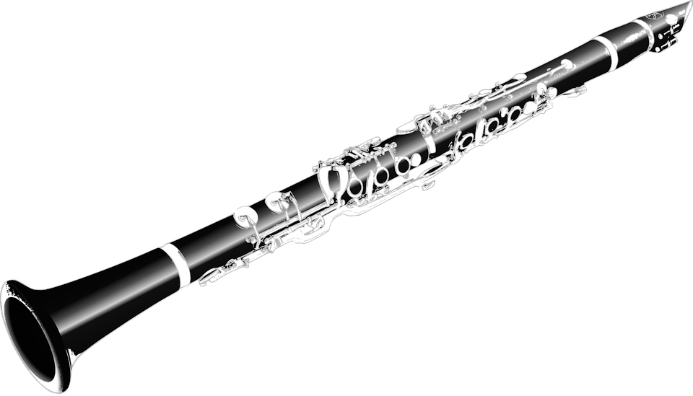
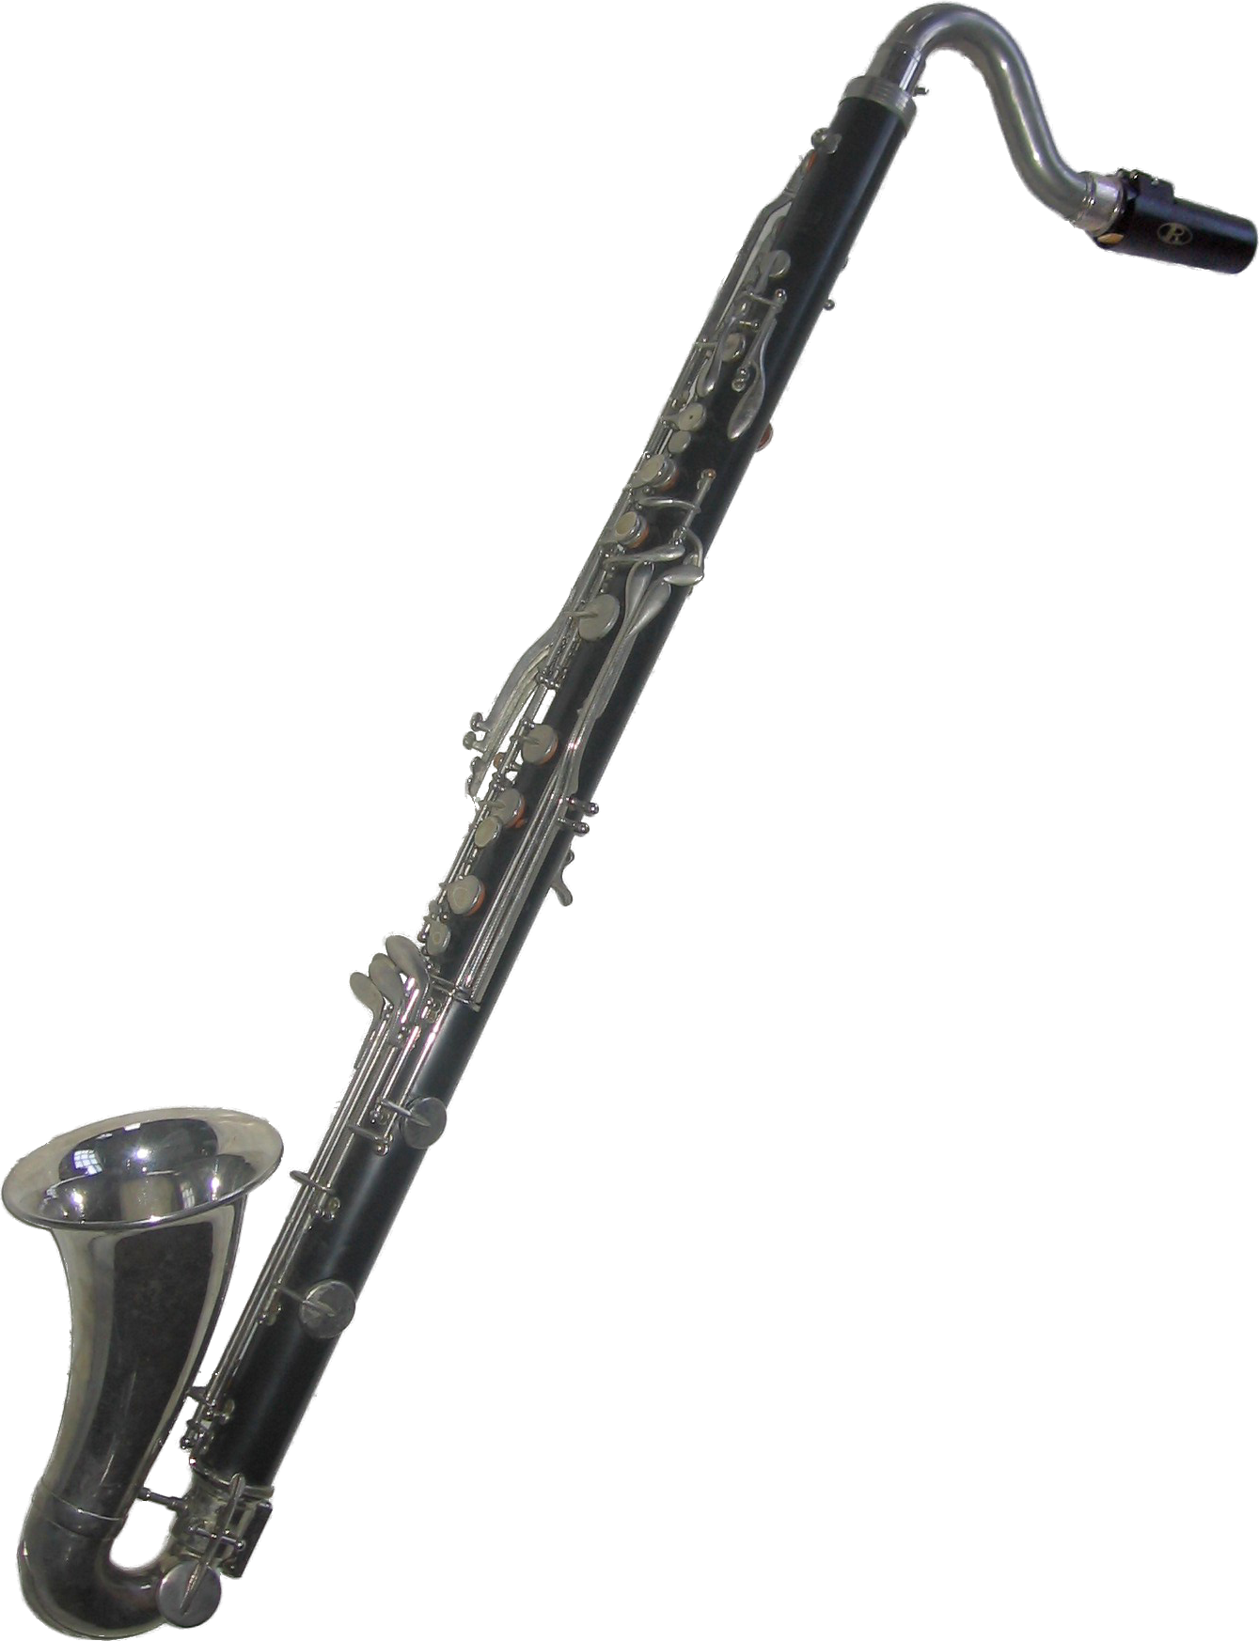
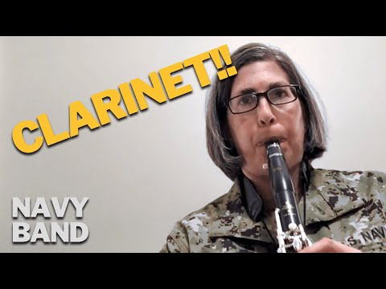
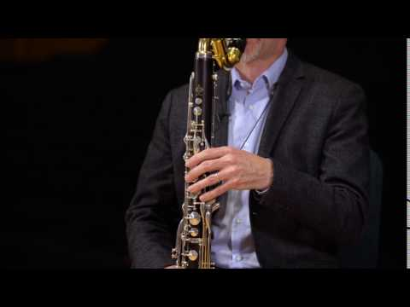
Woodwind Instruments
ABOUT THE CLARINET:
It’s a high-pitched instrument that uses a reed and has a large range.
Clarinet fingerings can become challenging after the first year of instruction, good for players who like a challenge.
Clarinets often play the melody, which requires quick fingers.
PHYSICAL CHARACTERISTICS NEEDED:
Clarinet players need to cover holes completely with their fingers to create a seal for their notes.
Clarinet players must be able to create a firm grip on the mouthpiece with their top teeth, lower jaw, and facial muscles (creating a facial shape like drinking a milkshake out of a straw).
Clarinet
Play the video
Interested students may switch to the bass clarinet in the second semester (January).
Play the video

Slide 8
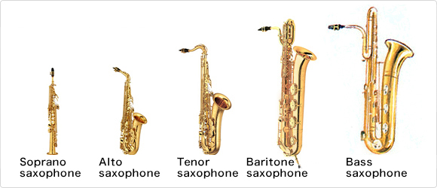
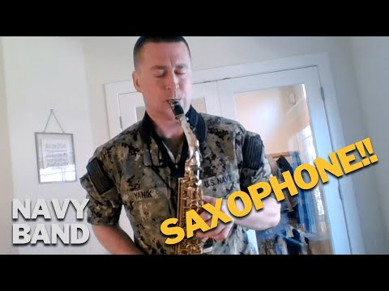
Woodwind Instruments
Alto Saxophone
Originally there were 14 members of the saxophone family. In fact, Adolphe Sax conceived of an orchestra consisting solely of saxophones, and so he made saxophones in a range of sizes. Yet today, there are only 6 types in widespread use. In pitch order from high to low, they are the sopranino, soprano, alto, tenor, baritone and bass. The alto, tenor, and baritone saxophone are used in band. Interested students may play the tenor and baritone saxophones (1) in the second semester.
ABOUT THE SAXOPHONE:
The saxophone uses a reed and has a brass body with many keys.
Saxophones often play melody parts and also provide rich harmonies.
PHYSICAL CHARACTERISTICS NEEDED:
Saxophone players should have fairly large hands to press all of the keys fully without accidentally bumping any side keys.
Saxophonists must be able to create a firm grip on the mouthpiece with their top teeth and lower jaw, supported by their lower lip. Their facial shape will be similar to the clarinet, but more circular and relaxed.
Play the video

Slide 9
Brass Instruments
Trumpet
ABOUT THE TRUMPET:
The trumpet uses a combination of the three valves plus adjustments in buzzing and facial muscle tension to create sound.
Trumpets often play the melody with a big brassy sound.
PHYSICAL CHARACTERISTICS NEEDED:
Trumpet players need to create a tight buzz, which can be created by pressing the lips together as if saying the letter “M,” and blowing fast air through vibrating lips.
Trumpet players should have a good musical ear and be able to tell if notes are higher or lower than one another.
Play the video

Slide 10
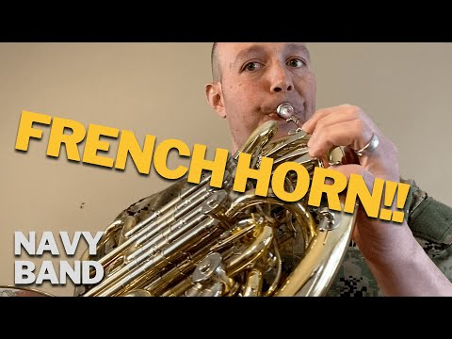
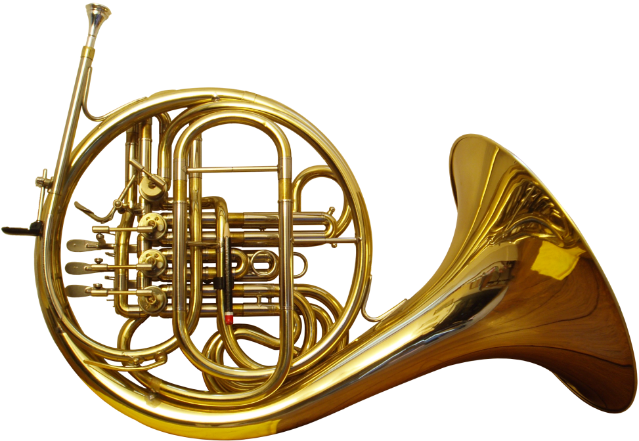
Brass Instruments
French Horn
The French horn is a brass instrument made of tubing wrapped into a coil with a flared bell. The double horn in F/B♭ is the horn most often used by players in professional orchestras and bands. Musicians don’t just place their hands in French horns to hold them in position. It actually affects the pitch of certain notes. A musician who plays a horn is known as a horn player or hornist. This instrument is available to interested students in the second semester (January).
Play the video

Slide 11
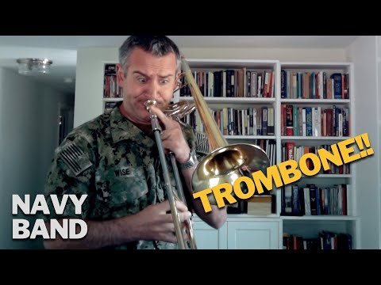
Brass Instruments
Trombone
ABOUT THE TROMBONE:
The trombone uses a slide that is moved to particular positions plus buzzing lips to create its low notes.
The trombone is part of the low brass section.
PHYSICAL CHARACTERISTICS NEEDED:
Trombone players need to buzz their lips together, by saying “M” and then pushing air through their lips creating a buzz.
Trombone players must have fairly long arms in order to move the slide fully.
Trombone players should have a good musical ear to adjust the slide to the exact positions needed for each note.
Play the video

Slide 12
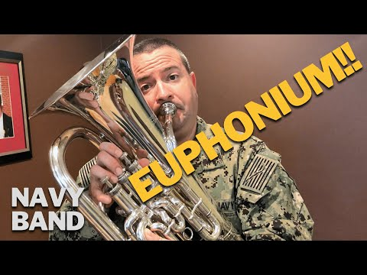
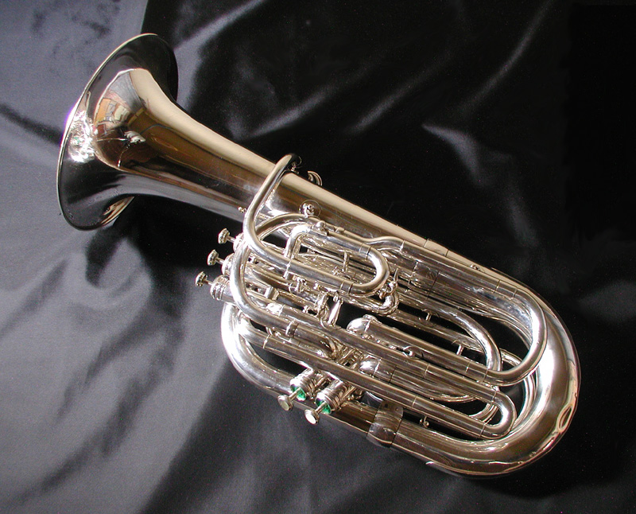
Brass Instruments
Euphonium/Baritone
ABOUT THE EUPHONIUM/BARITONE:
The euphonium uses a combination of the three valves plus adjustments in buzzing and facial muscle tension to create sound.
Another name for the Euphonium is the Baritone. We will use both names!
The euphonium/baritone is part of the low brass section.
The euphonium has a rich, warm sound.
PHYSICAL CHARACTERISTICS NEEDED:
Baritone players need to buzz their lips together, by saying “M” and then pushing air through their lips, creating a buzz.
Euphonium players should have a good musical ear and be able to tell if notes are higher or lower than one another.
Play the video

Slide 13
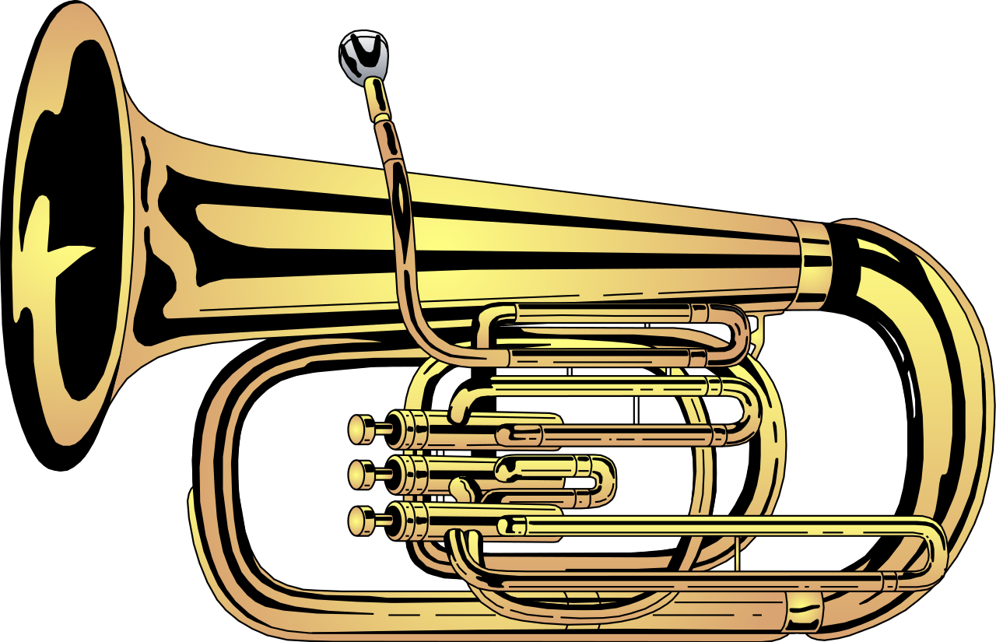
Brass Instruments
ABOUT THE TUBA:
The tuba uses a combination of the three valves plus buzzing to create sound.
The tuba is the lowest member of our low brass section and the “boss of the band,” creating the foundation for our band!
PHYSICAL CHARACTERISTICS NEEDED:
Tuba players need to buzz their lips together more loosely, making their lips a bit “floppy” by making a duck face and then pushing their air through their lips.
Tuba players should have a good musical ear and be able to tell if notes are higher or lower than one another.
Tubists must use a lot of air and be willing to manage a big instrument.
Tuba
Play the video

Slide 14
Percussion
The percussion section will not begin until mid-January. The percussion section will have space for only EIGHT students. Students will have to audition for this section. The audition will consist of a rhythm and note reading assessment, as well as proficiency on their beginner instrument. If selected, percussion students will rotate within the section on bells, timpani, snare and bass drum. All students will begin on a wind instrument and must be enrolled in band from the beginning of the school year. More information will be forthcoming later in the semester.

Slide 15
Obtaining an Instrument
Getting an instrument, band method book, and supplies for your child:
A. It is the parent's responsibility to get an instrument for their child. I suggest using a reputable full-service dealer, who offers a rental plan. There are a limited amount of school instruments available for students' use. Please contact me ASAP if your student needs to use a school owned instrument.
B. All students will need to provide their own band method book and instrument supplies. Please refer to the beginning band supply list that is posted on my web page. Students will need to have instruments in class by September 3.

Slide 16
Obtaining an Instrument
Music retail stores are available to set up instrument rentals online and in person over the summer. Plan to visit their website to set up your rental or visit their store to discuss arrangements or to try out an instrument.
If you have an instrument that is already owned, or if you are purchasing from a private seller, please take that instrument to a repair shop to make sure it is working properly.

Slide 17
Obtaining an Instrument
BEWARE OF ISOs (Instrument-Shaped Objects)
These are the cheap instrument-shaped objects found on online auctions, other internet sources, and large chain stores.
Although I will refrain from mentioning specific stores, keep in mind that if you can also buy toilet paper, jeans, or tires from the store, then it is not a music store, and it will not have musically knowledgeable personnel. You get what you pay for. If it’s inexpensive, it’s not a quality instrument.

Slide 18
Obtaining an Instrument
Warning!
Beware of getting a “too good to be true” deal on an instrument from an online source or from a private seller. There are MANY instrument companies that sell very cheap, sub-standard instruments. Very cheap instruments break easily and often cannot be repaired due to their cheap materials. No instrument shaped objects!

Slide 19
Instrument Supplies
Accessories for each instrument are listed in the Supplies Handout, and include supplies necessary for keeping the instrument clean and in good working condition (examples: reeds, cork grease, slide grease, valve oil, polishing cloth)
Supplies can be purchased already arranged in a “care/cleaning kit” from music retail stores that sell instruments.

Slide 20
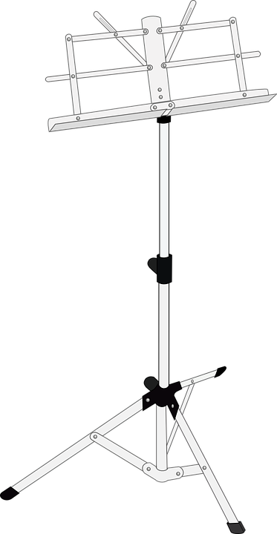
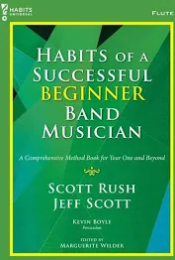
Instruments and Supplies
All students need a Habits of a Successful Beginner Band Musician method book for their specific instrument and a pencil
Students are highly encouraged to purchase a wire folding stand. It makes at-home practice much more comfortable.
Metronomes and tuners can also be very helpful. We recommend the free Bandmate tuner app for our brass students! Metronomes and tuners are available as apps.

Slide 21
Instruments and supplies Do not purchase plastic instruments or instruments that are colored pink, red, purple, blue, etc. I have listed acceptable colors below for each instrument. Below is a list of quality instrument brands to look for when renting or purchasing.
*Flute:
Flute cleaning kit
*Recommended Flute brands: Armstrong, Jupiter, Emerson, Yamaha, Gemeinhardt –Gold or silver plated color
*Clarinet:
Clarinet cleaning kit
Neckstrap
*Size 2 ½ Mitchell Lurie/Juno/Vandoren brand reeds (no Rico brand reeds)
*Recommended Clarinet brands: Vito, Jupiter, Buffet, Artley, Selmer, Yamaha - black
*Alto Saxophone:
cleaning kit
*4-size 2 ½ Vandoren brand reeds
*Recommended Alto Saxophone brands: Regent, Vito, Yamaha, Jupiter- black, silver or gold colored
*Trumpet:
*Trumpet cleaning kit
Recommended trumpet brands: Conn, Besson, Yamaha, Bach, King-gold or silver colored
Trombone:
*Trombone cleaning kit
Recommended trombone brands: Jupiter, Holton, Conn, King, Bach, Yamaha –gold or silver colored

Slide 22
Local Music stores who rent and sell instruments (this is an unbiased and impartial list)
Moore Music Music and Arts
615 W Market St 609 Lawndale Drive
Greensboro NC 27401 Greensboro, NC 27408
336-274-4636 (336) 282-1256
www.mooremusiccompany.com
Greensboro Music Company
500 N. Greene Street
Greensboro, NC 27401
336-279-8833 Music Go Round
www.Greensboro-music.com 1622 Stanley Rd
Greensboro, NC 27407
(336) 854-4460
www.musicgoround.com
https://stores.musicarts.com/nc/greensboro/music-store-4204.html

Slide 23
When are instruments needed?
Instruments are needed in class for instrument instruction beginning
SEPTEMBER 3, 2024.

Slide 24
Will my child need to practice?
YES!
Learning this new activity requires the use of new muscles and coordination patterns.
Plan for your child to practice at least 15 minutes, four times a week.
Schedule a regular time and location at home to build a routine.
Students will be given techniques at school for practicing.

Slide 25
Practice Tips for Parents
Even if you don’t know anything about playing an instrument, ALL parents can help their child improve through practice by listening, asking questions, and making encouraging comments.
Sit with your child for some of their practice time.
Vary what they practice: choose their lesson book assignment, concert music, or even purchase a “fun music” book from the music store for added excitement.
.

Slide 26
What are classroom expectations for band?
As a performance-based class, students are expected to fully participate, actively listen, comply with classroom instructions, and strive to improve. This is crucial in our band classes.

Slide 27
How can I help my child be successful?
Encourage your student to maintain an “I Can” attitude, where they seek constant improvement and believe that they can improve with effort.
Contact Mrs. White if your child is struggling or frustrated, and we can work together to develop a strategy to help them succeed.

